Slide 1
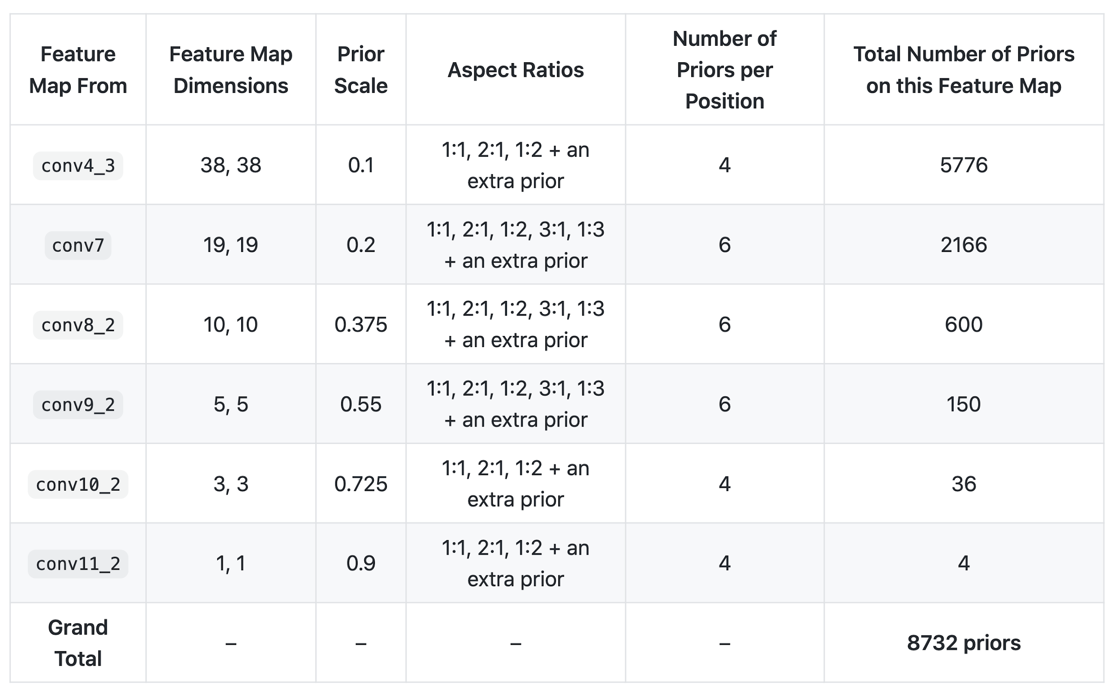
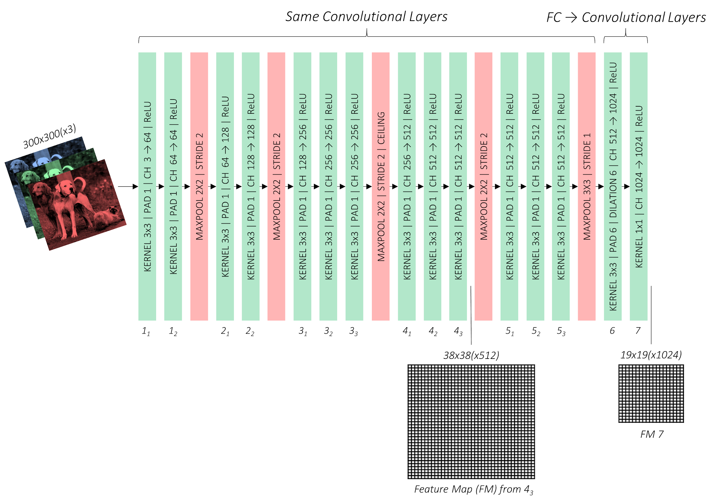
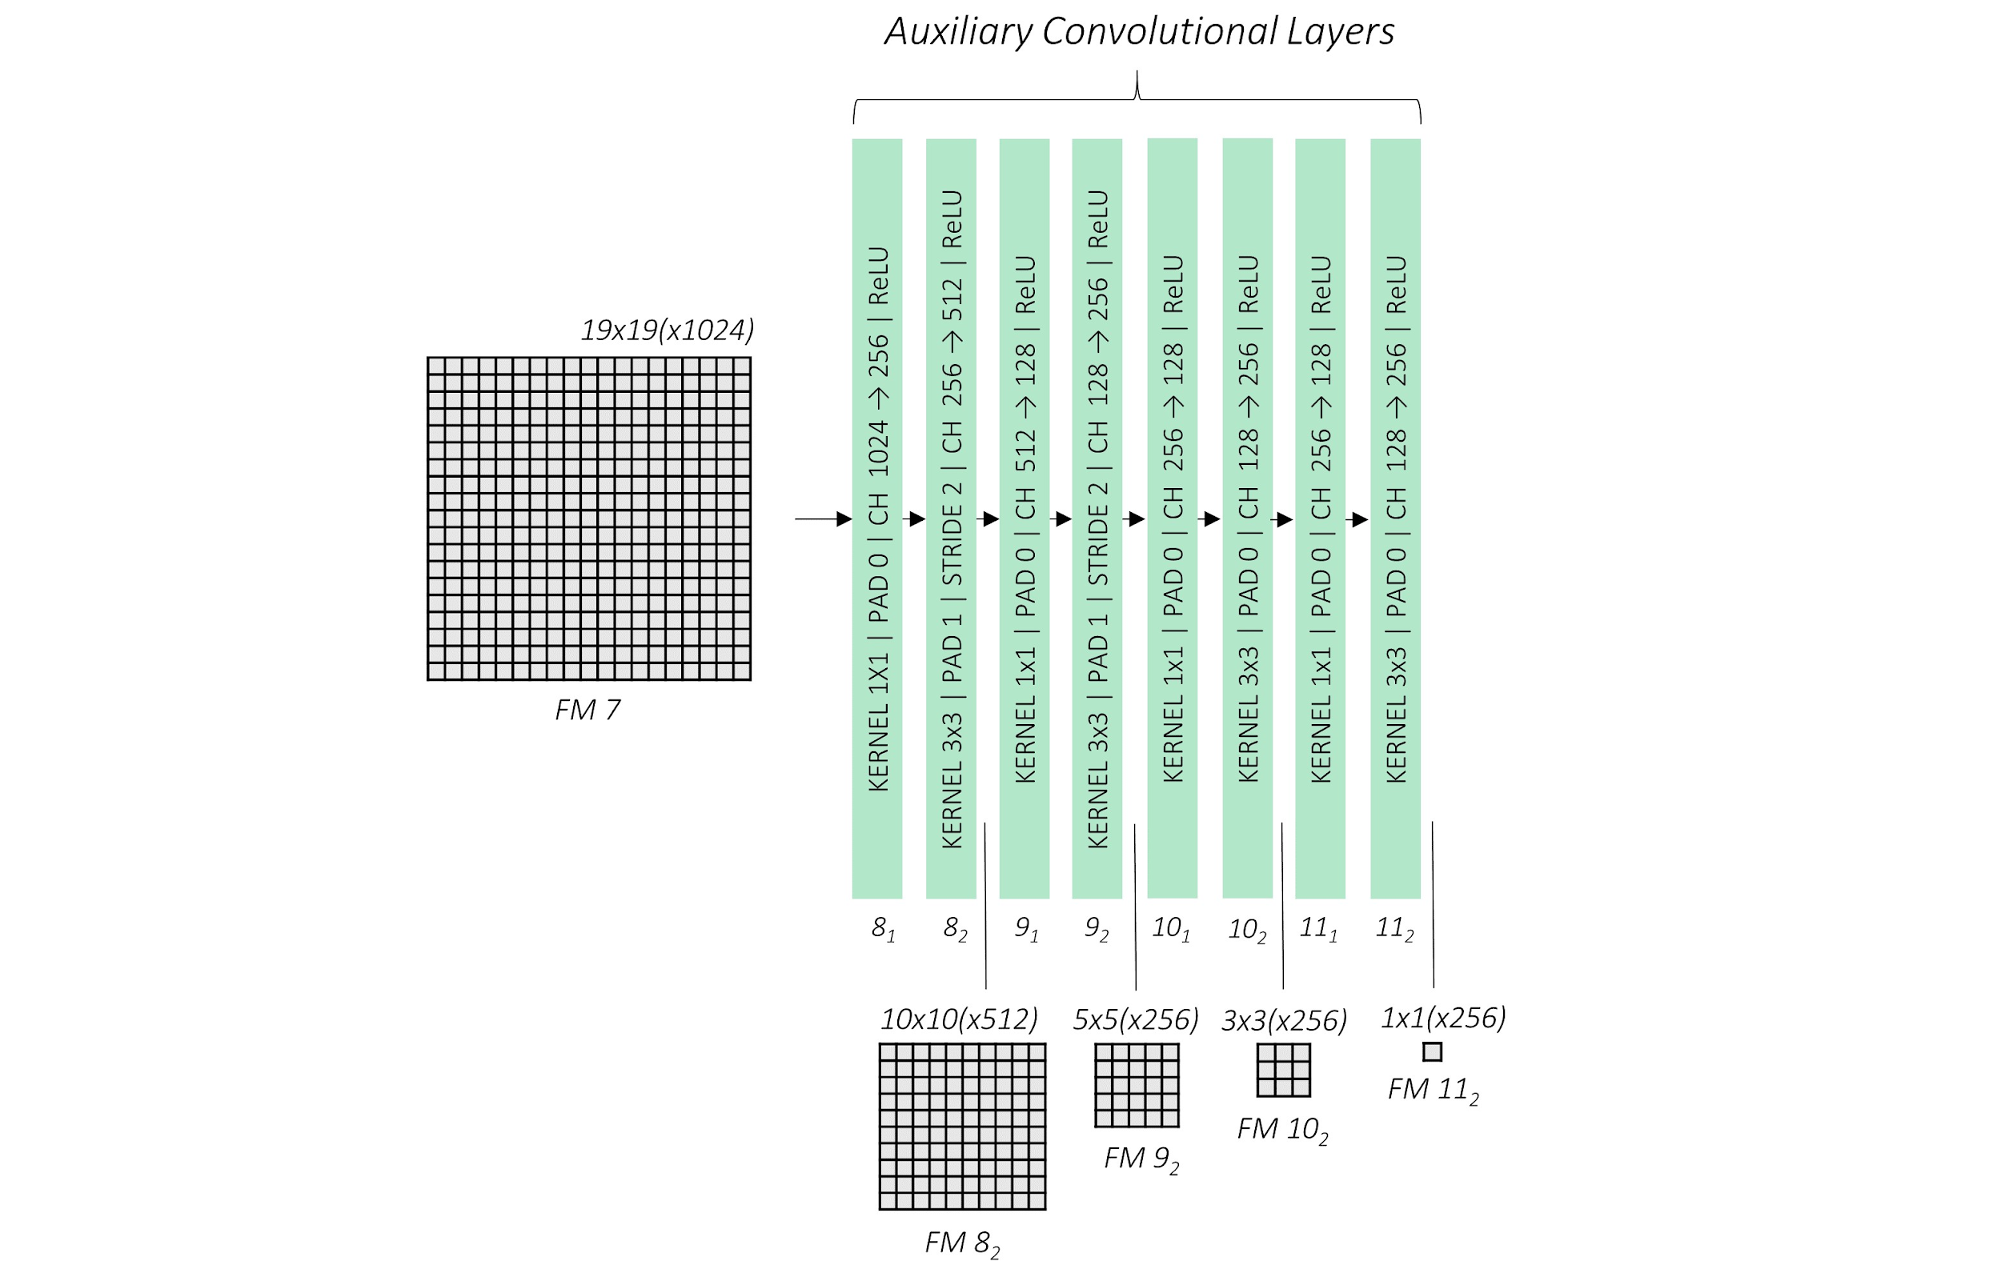
SSD: number of default boxes
https://github.com/sgrvinod/a-PyTorch-Tutorial-to-Object-Detection

Slide 2
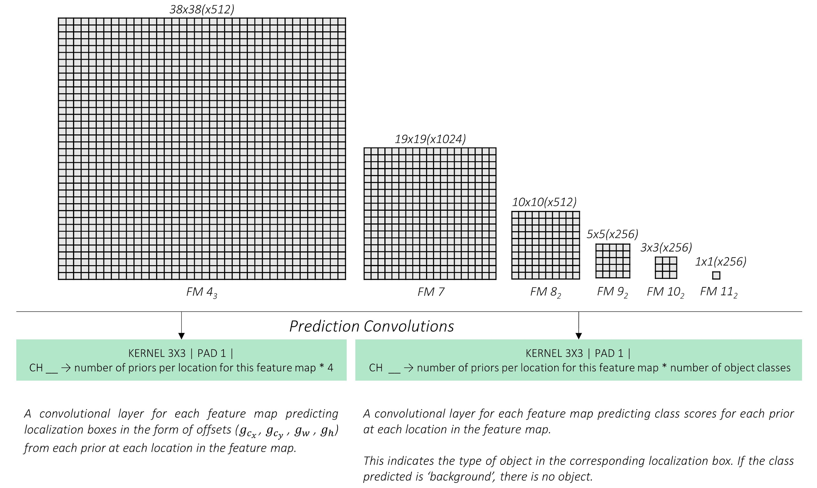
SSD: prediction convolutions
https://github.com/sgrvinod/a-PyTorch-Tutorial-to-Object-Detection

Slide 3
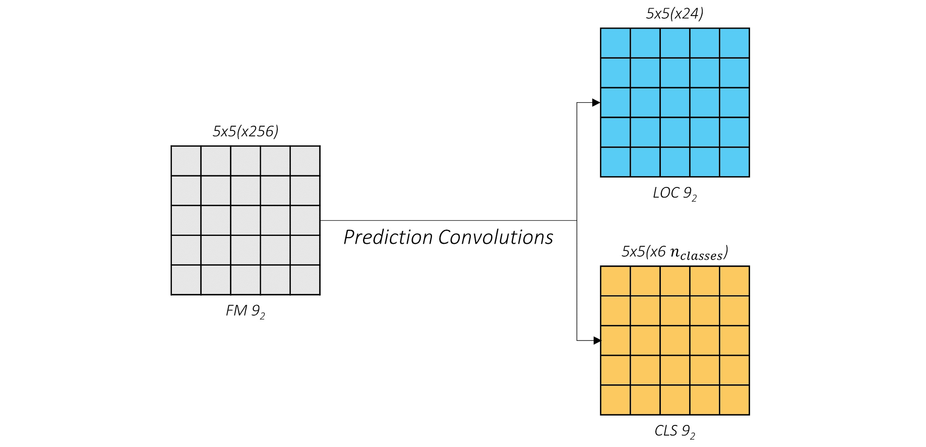
SSD: prediction scheme
https://github.com/sgrvinod/a-PyTorch-Tutorial-to-Object-Detection

Slide 4
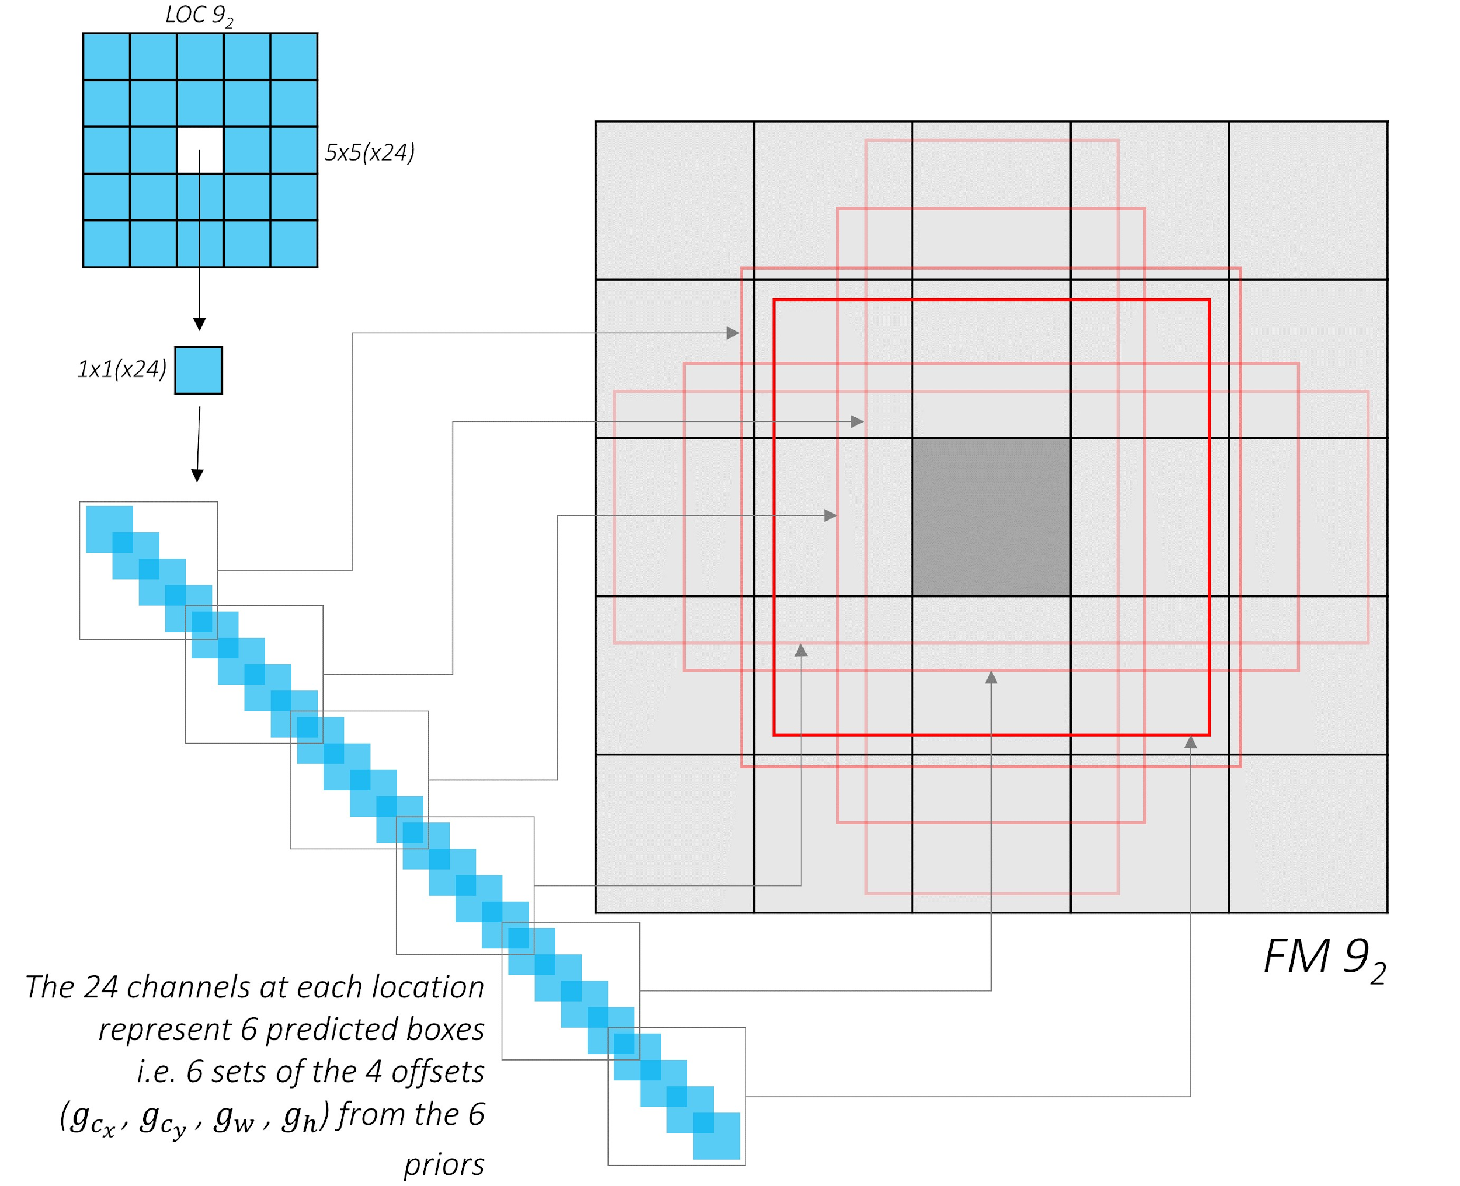
SSD: location coordinates channels
https://github.com/sgrvinod/a-PyTorch-Tutorial-to-Object-Detection

Slide 5
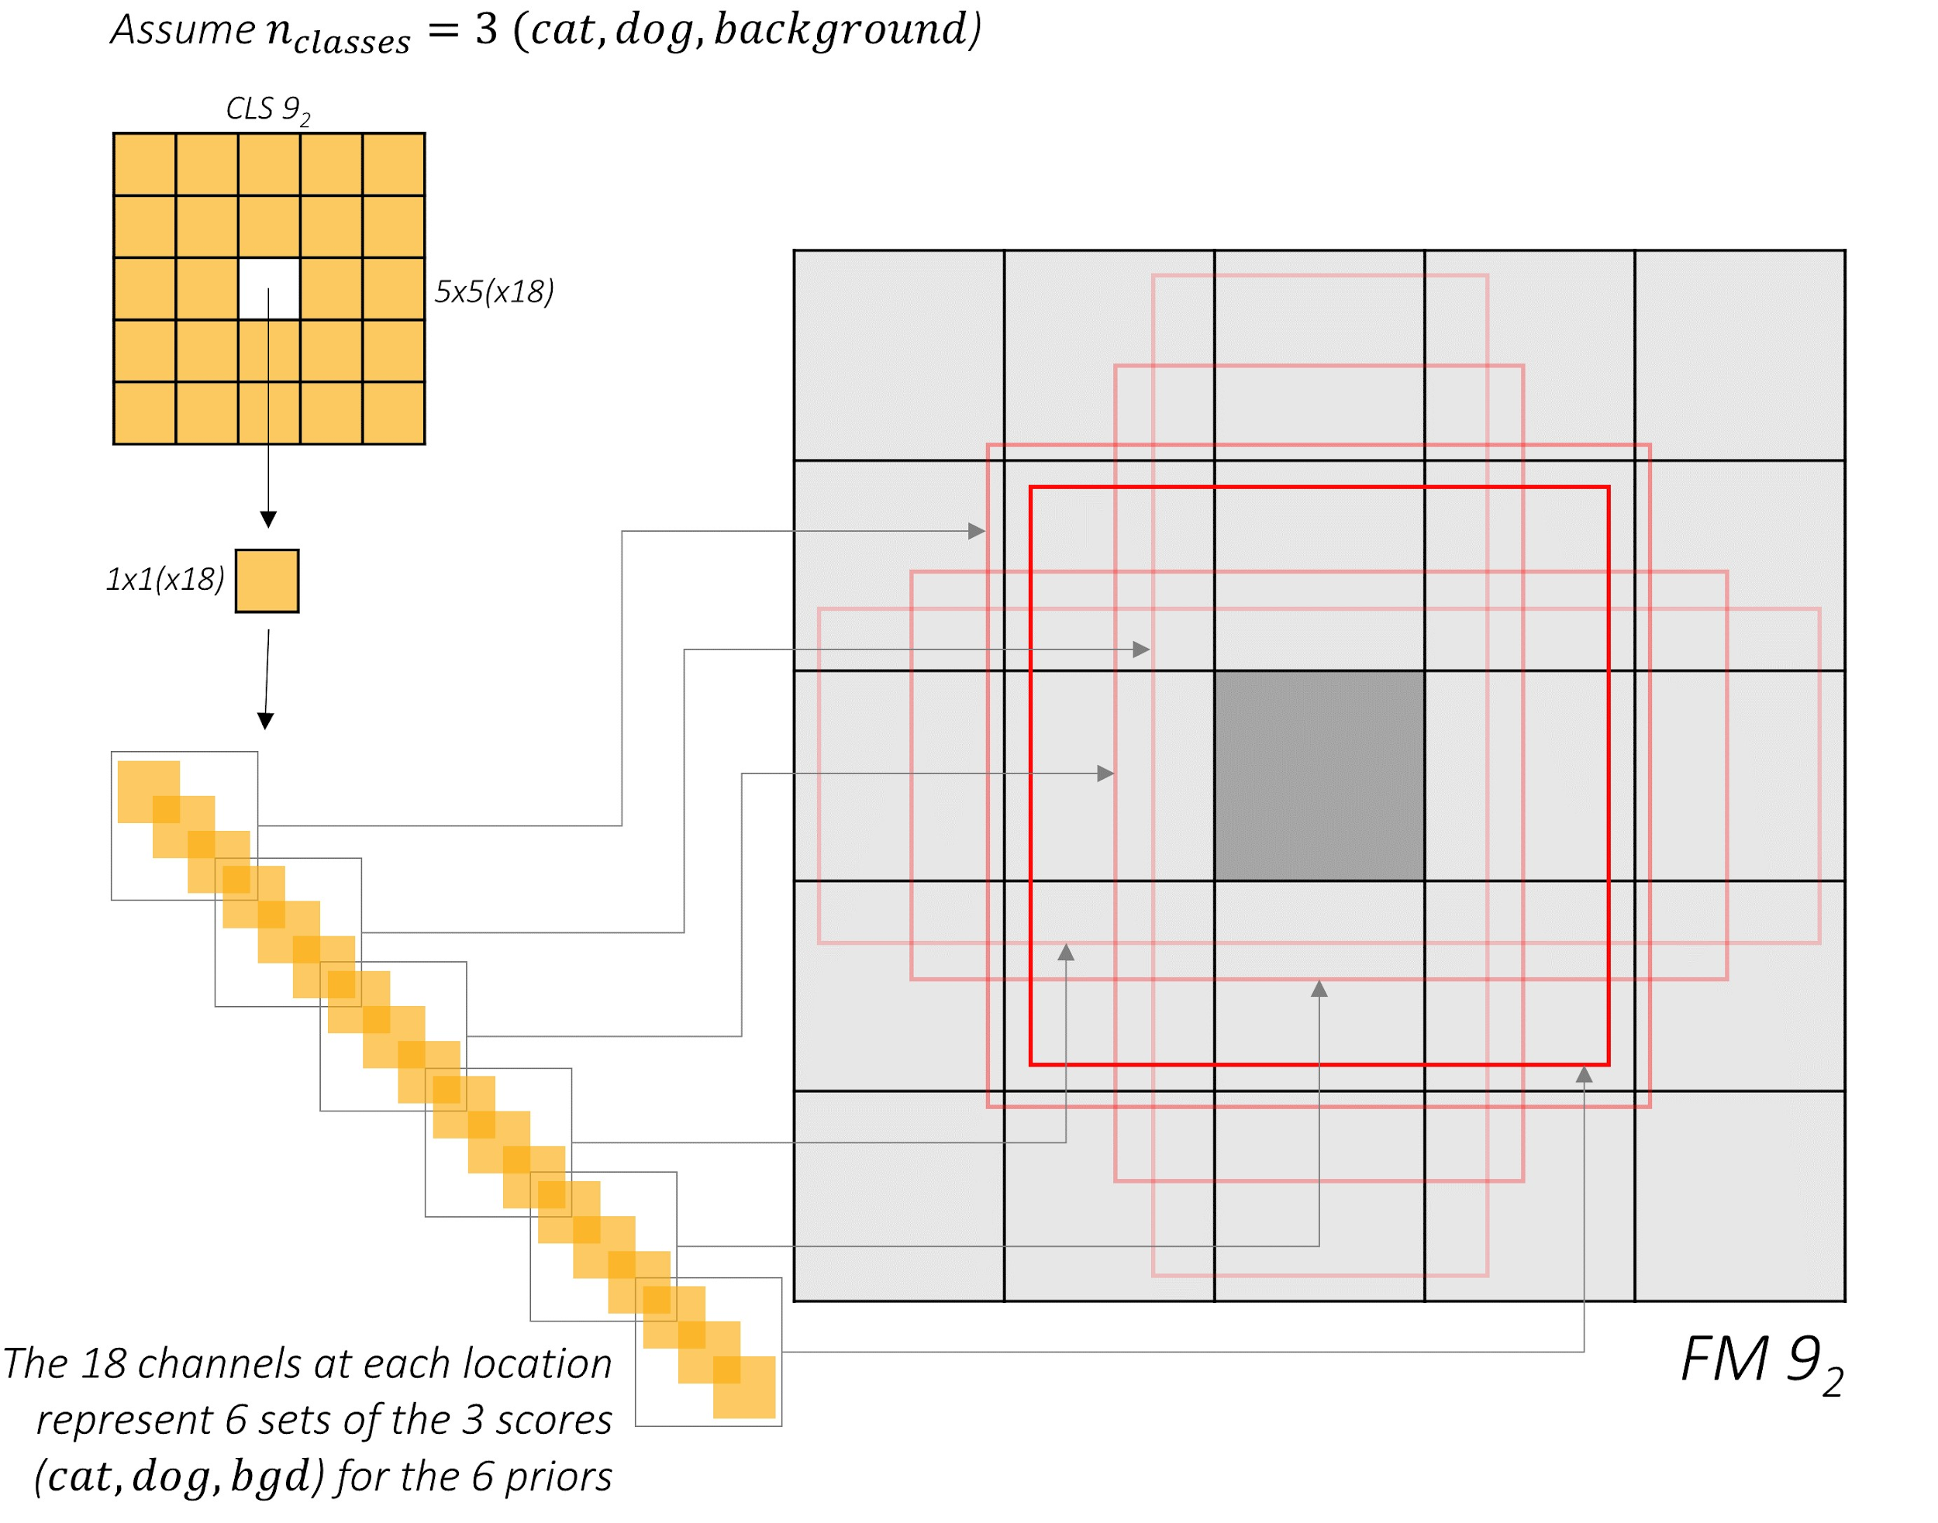
SSD: classification score channels
https://github.com/sgrvinod/a-PyTorch-Tutorial-to-Object-Detection

Slide 6
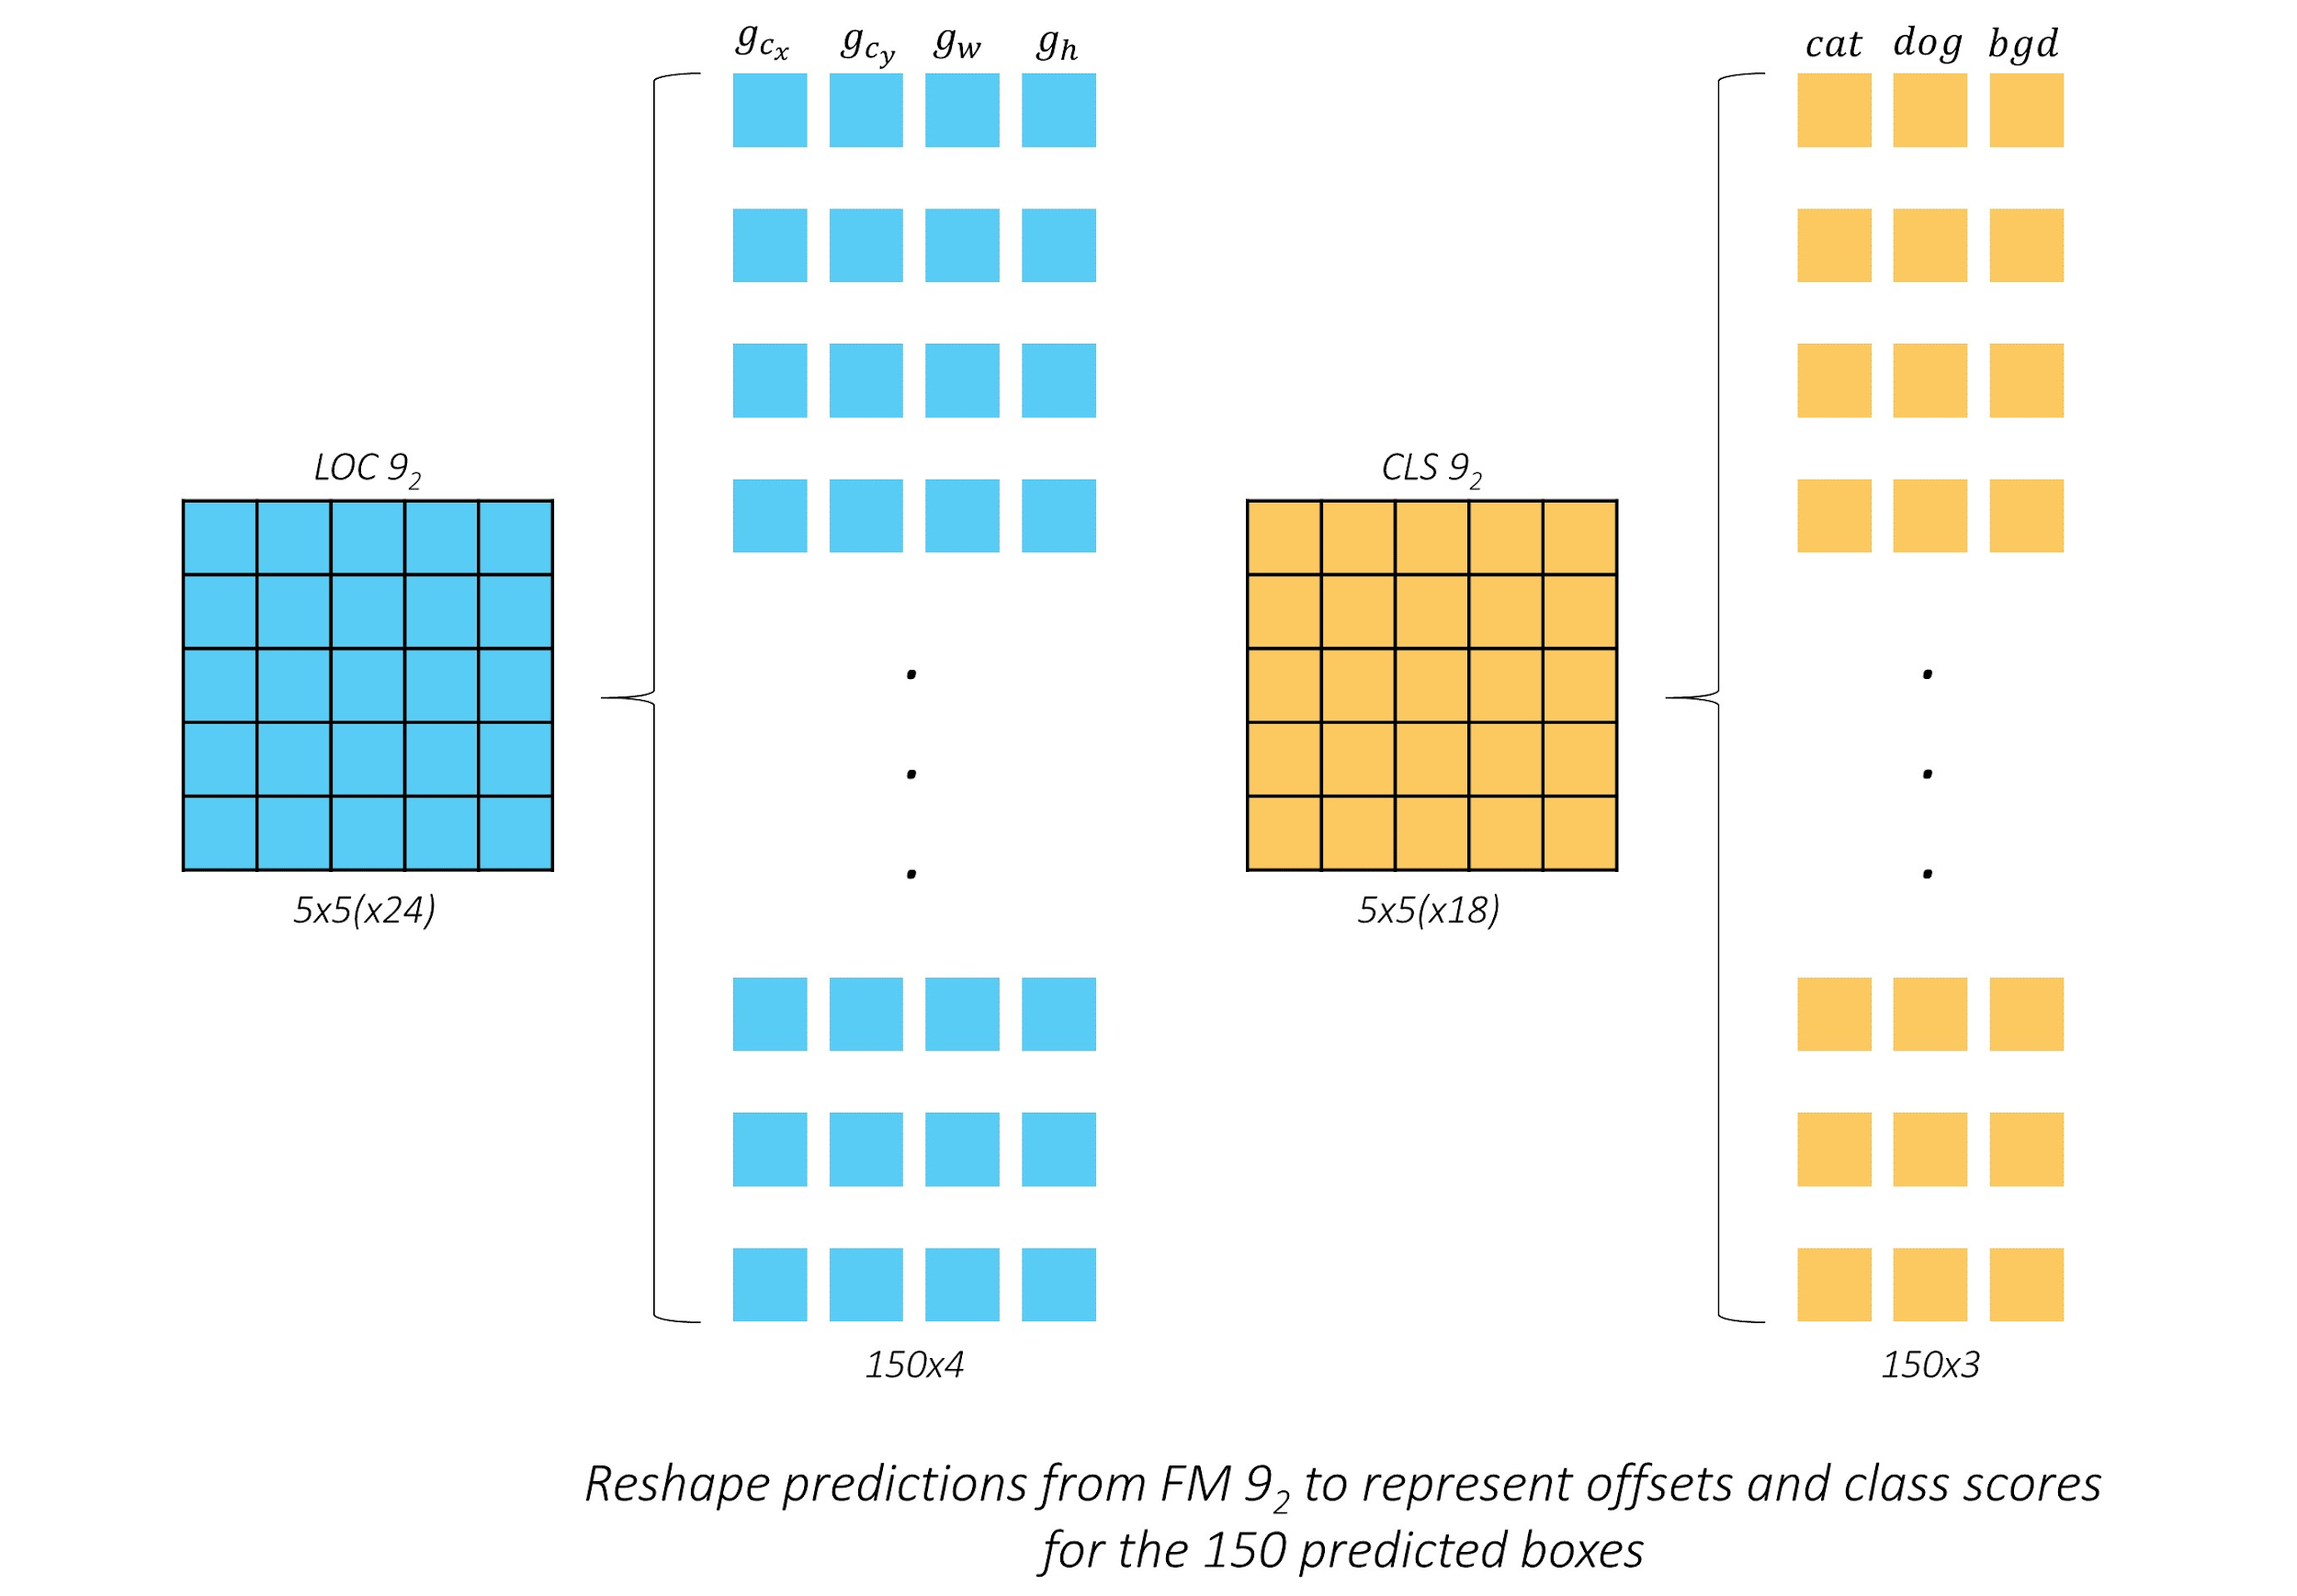
SSD: boxes of FM 9
https://github.com/sgrvinod/a-PyTorch-Tutorial-to-Object-Detection

Slide 7
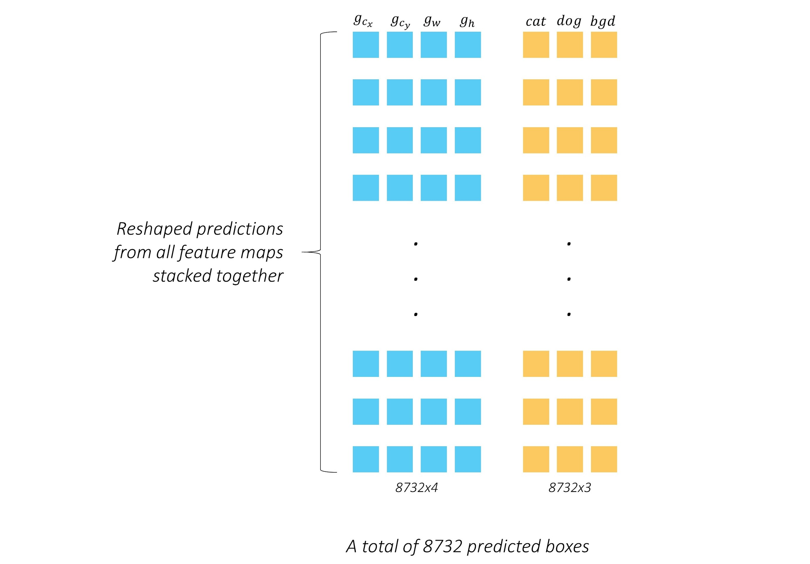
SSD: all predicted boxes
https://github.com/sgrvinod/a-PyTorch-Tutorial-to-Object-Detection

Slide 8
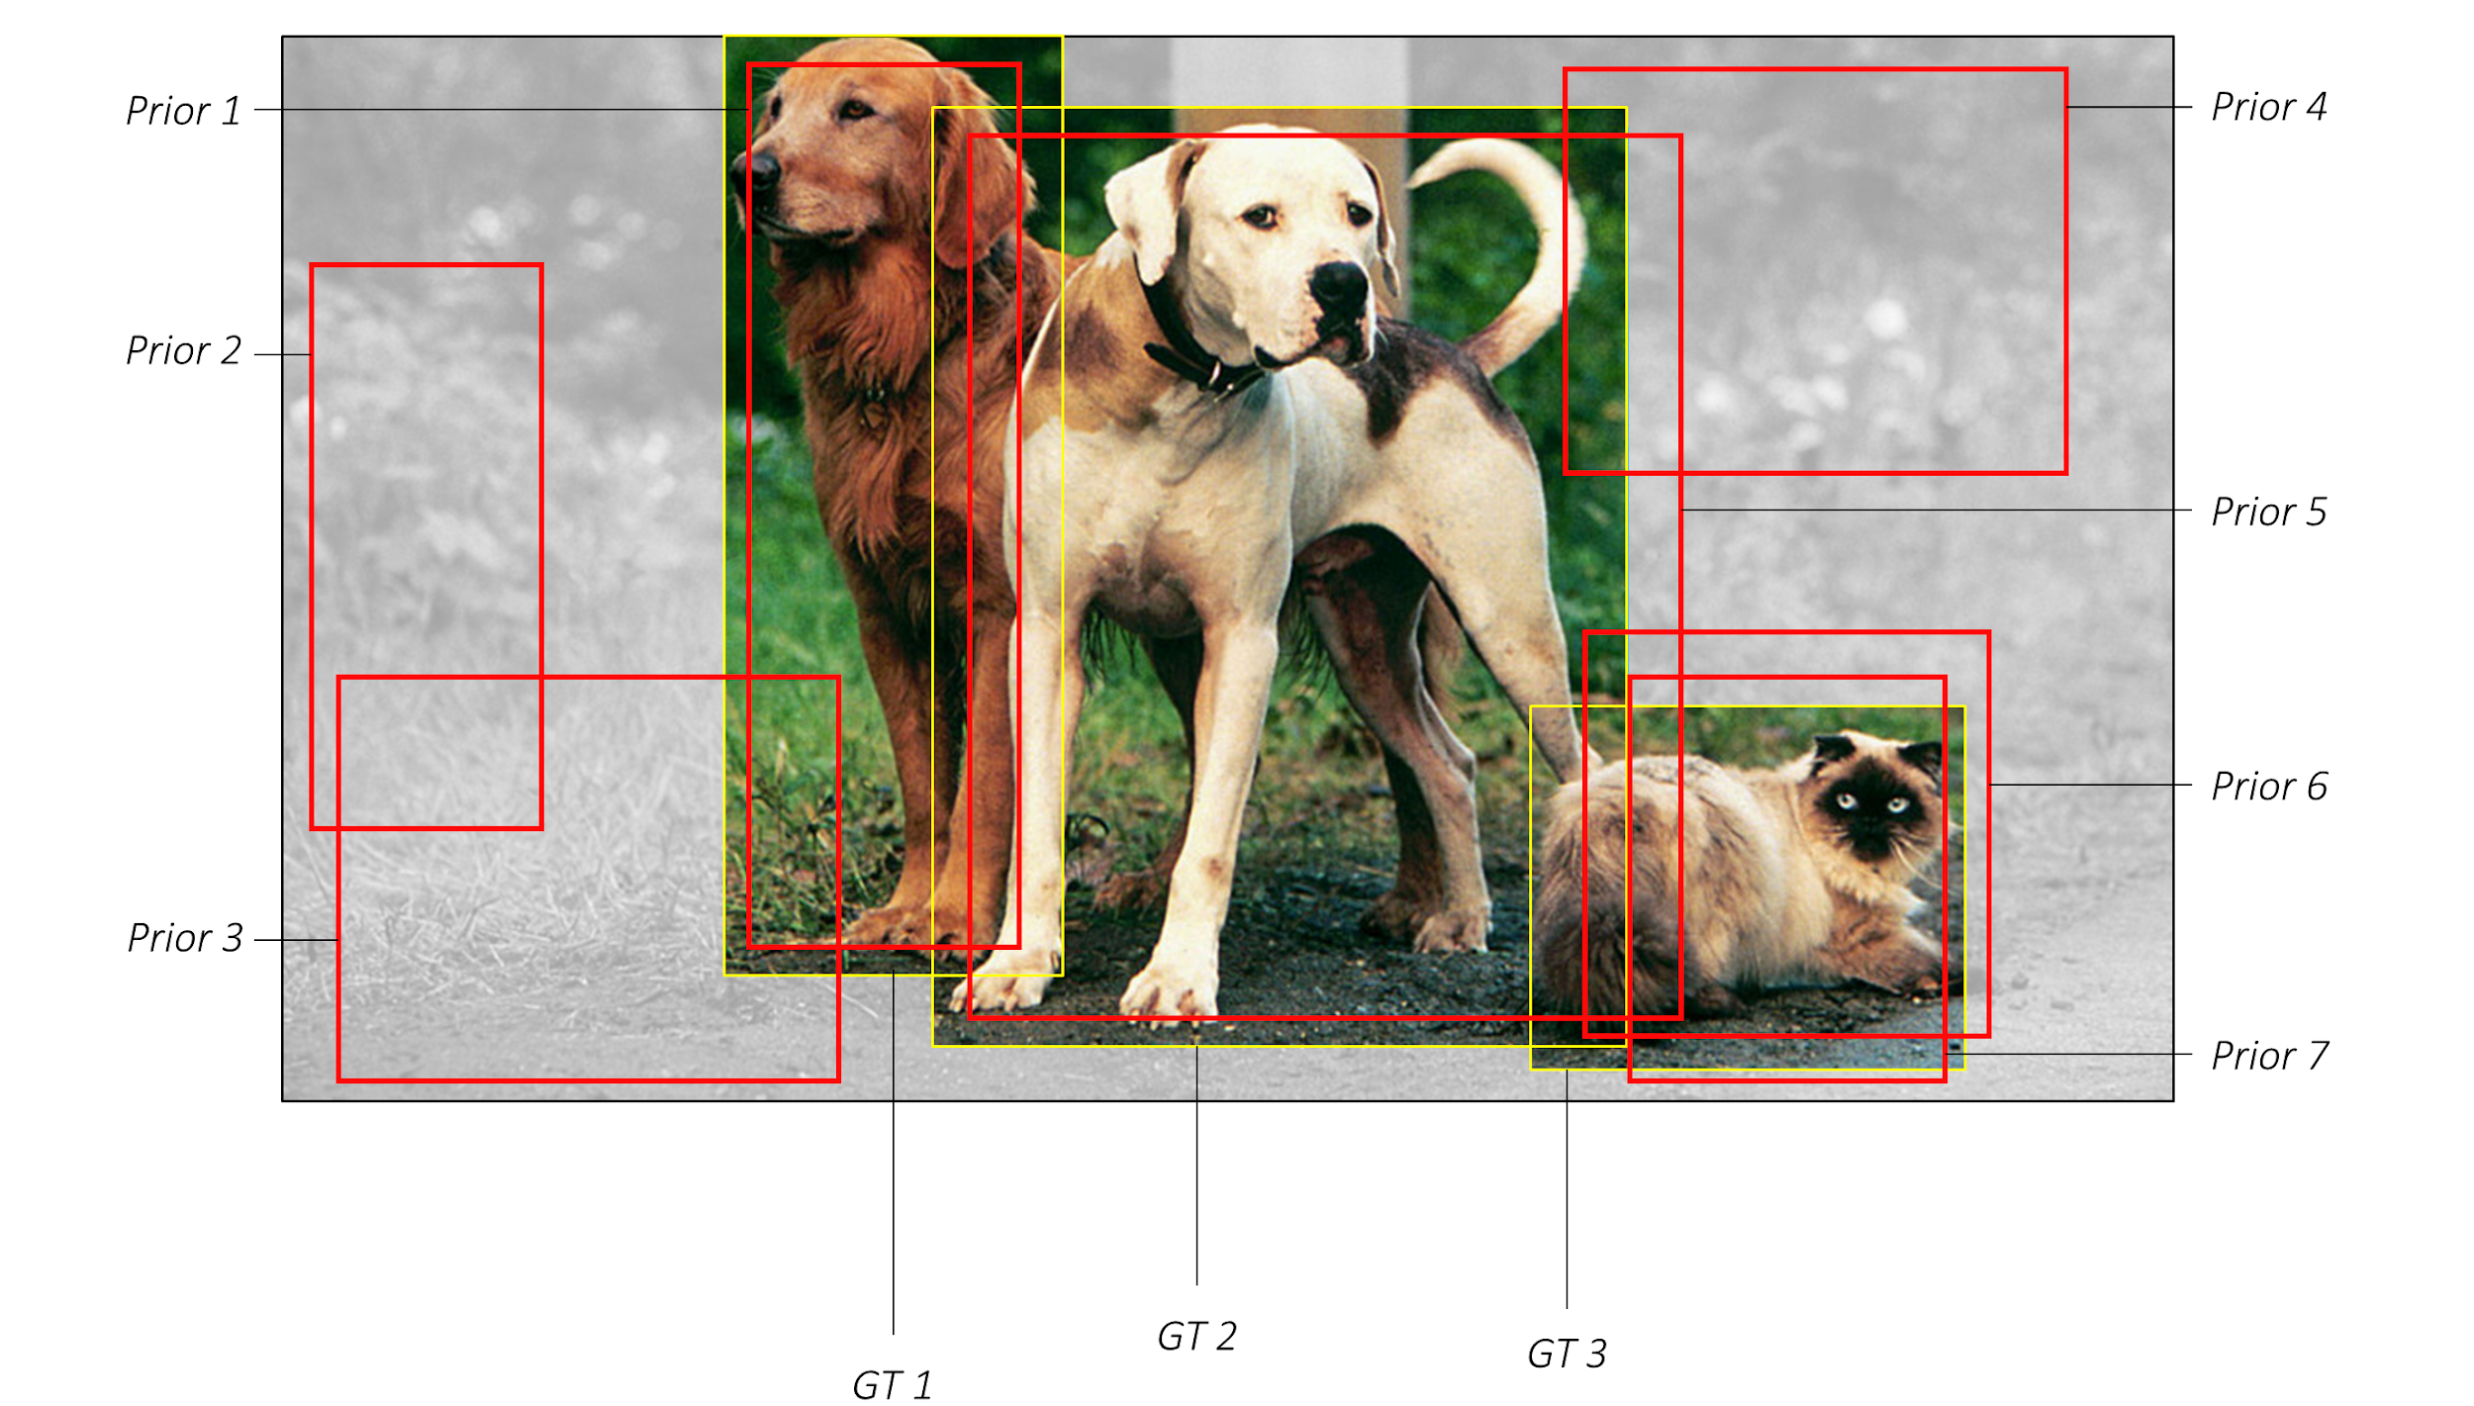
SSD: predictions
https://github.com/sgrvinod/a-PyTorch-Tutorial-to-Object-Detection

Slide 9
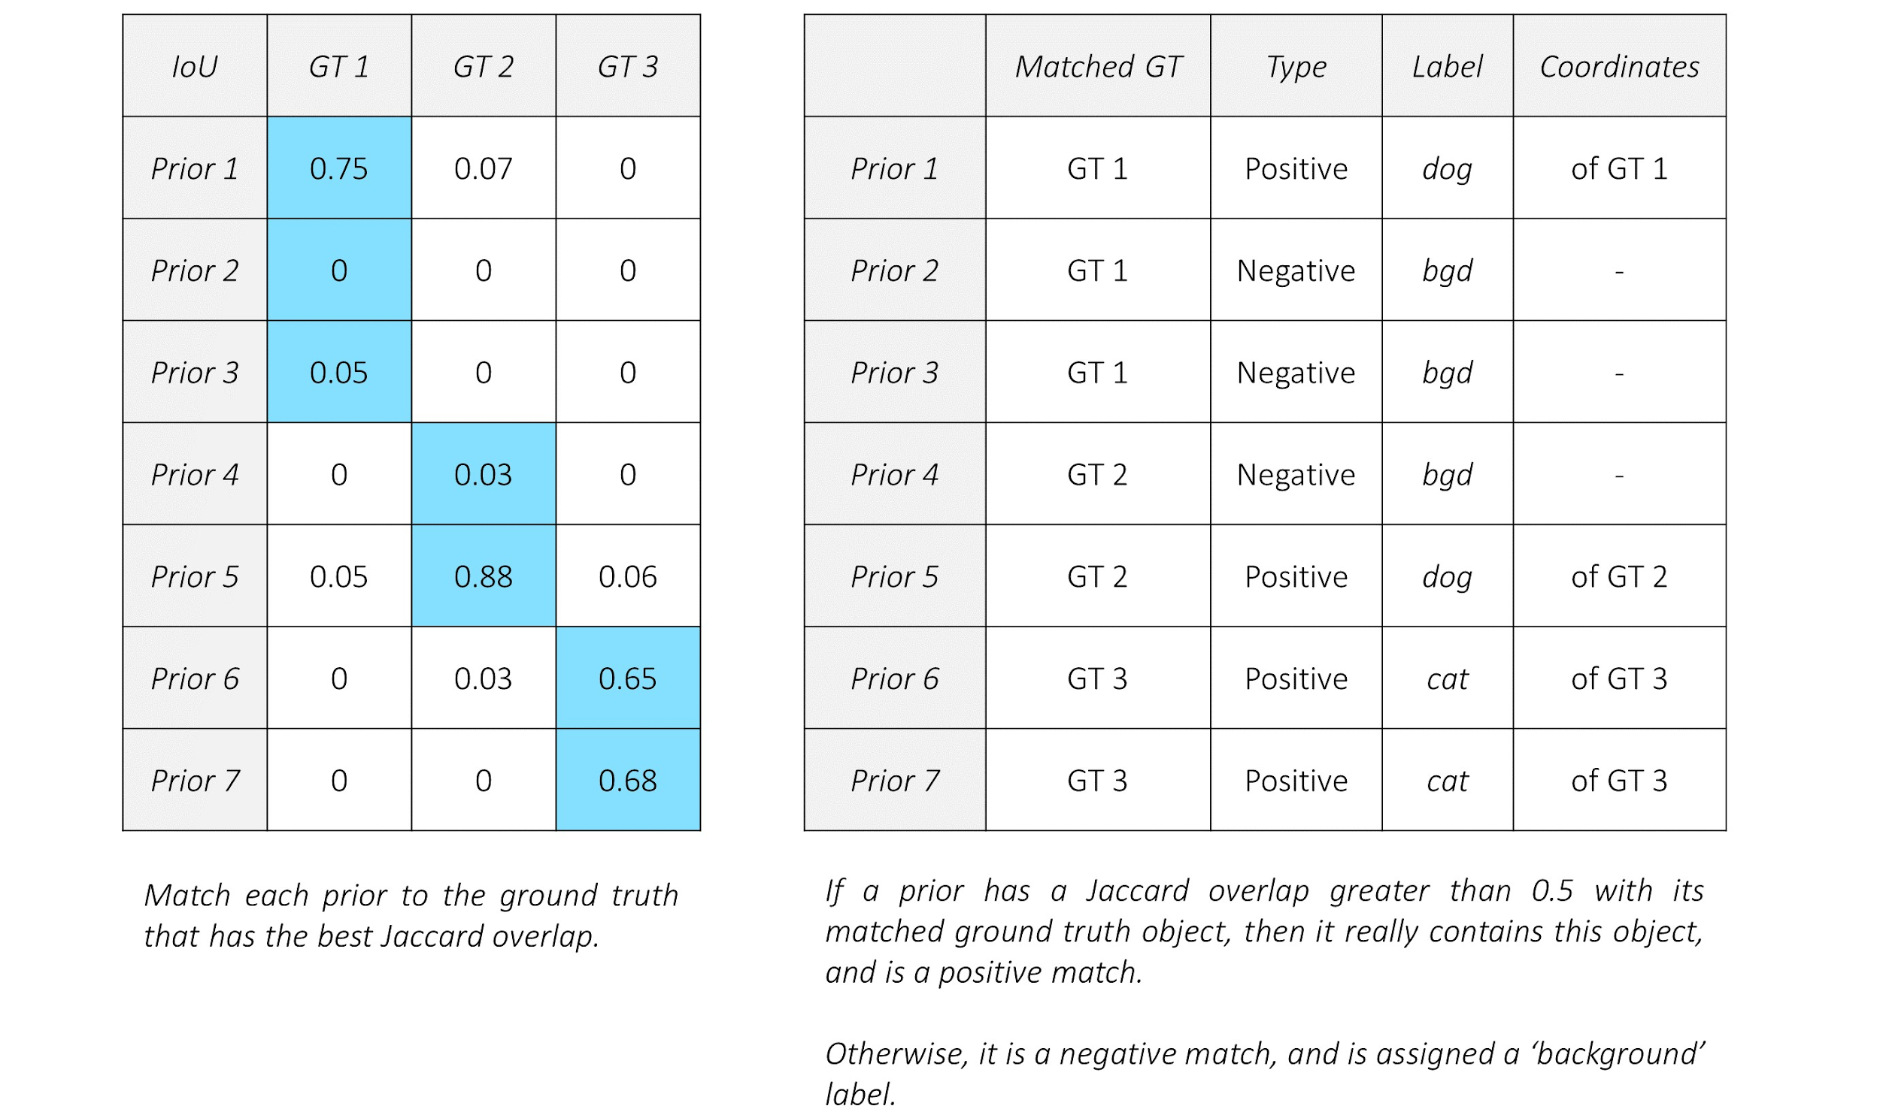
SSD: matching
https://github.com/sgrvinod/a-PyTorch-Tutorial-to-Object-Detection

Slide 10

SSD: coordinate regression loss
https://github.com/sgrvinod/a-PyTorch-Tutorial-to-Object-Detection

Slide 11
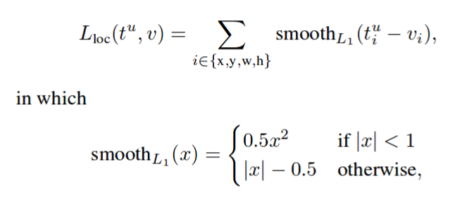
SSD: coordinate regression loss
https://github.com/sgrvinod/a-PyTorch-Tutorial-to-Object-Detection

Slide 12

SSD: classification loss + hard negative mining
https://github.com/sgrvinod/a-PyTorch-Tutorial-to-Object-Detection

Slide 13
SSD: classification loss + hard negative mining
https://github.com/sgrvinod/a-PyTorch-Tutorial-to-Object-Detection

Slide 14
SSD: classification loss + hard negative mining
N_hard_negatives = 3 * N_positives
https://github.com/sgrvinod/a-PyTorch-Tutorial-to-Object-Detection

Slide 15
SSD: full multibox loss
N_hard_negatives = 3 * N_positives
https://github.com/sgrvinod/a-PyTorch-Tutorial-to-Object-Detection

Slide 16
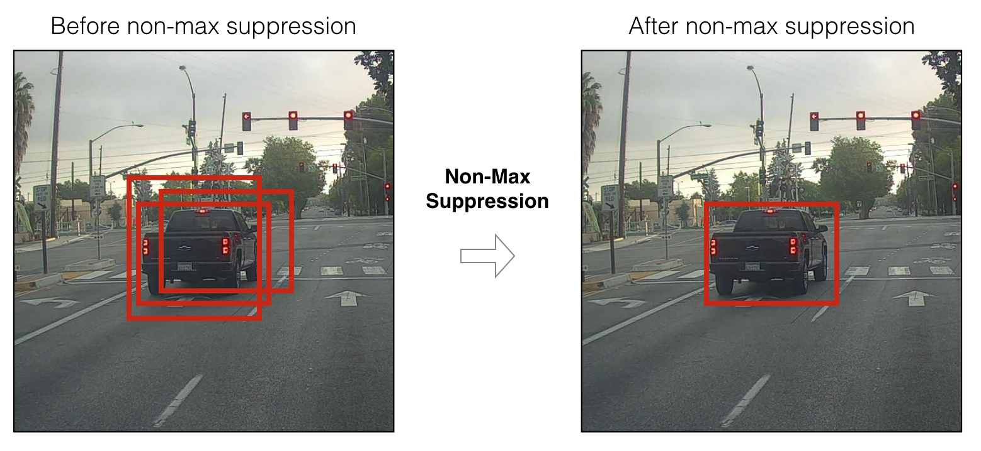
Detection: non-max suppression
For each class separately!

Slide 17
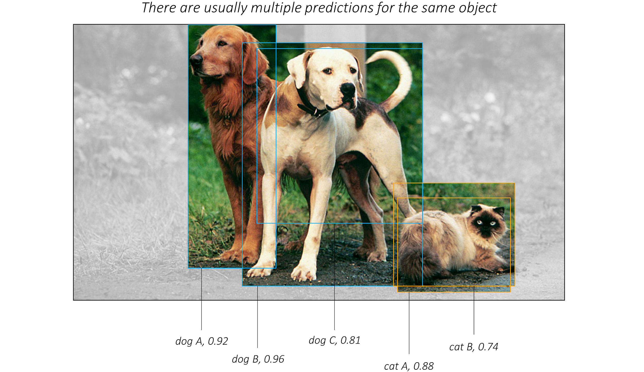
Detection: non-max suppression
https://github.com/sgrvinod/a-PyTorch-Tutorial-to-Object-Detection

Slide 18
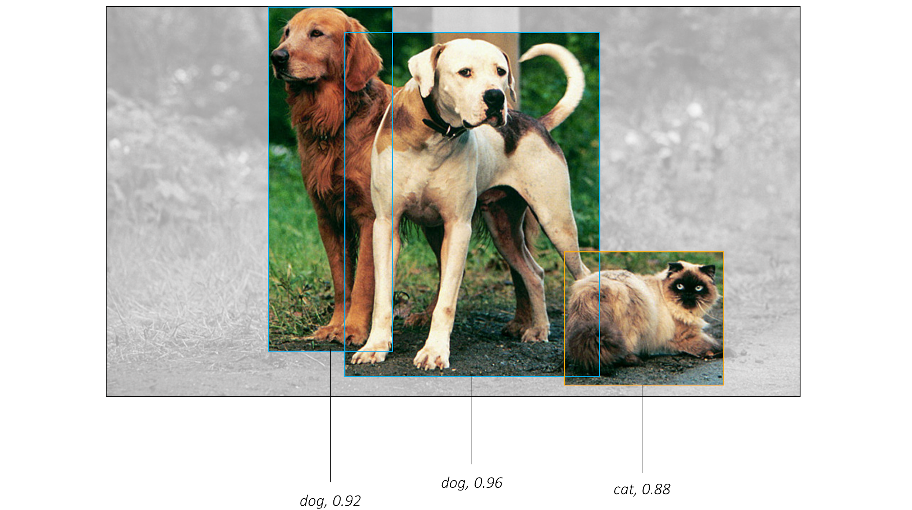
Detection: non-max suppression
https://github.com/sgrvinod/a-PyTorch-Tutorial-to-Object-Detection

Slide 19
Summary
One-stage detectors
In-depth SSD architecture

